Slide 1

Machine Learning Regression Models with Uber and Lyft Prices
By Oren Shapira

Slide 2
Purpose of Project
Primary purpose of project was to build Machine Learning Regression models to predict the price of Uber and Lyft rides. In doing so, I aimed to discover whether any variables (besides distance of ride) have a significant impact on price.
The regression models I tested and did comprehensive analysis on were Simple/Linear/Polynomial Regression, k-Nearest Neighbors Regression, Random Forest Regression, and Gradient-Boosting. I also did basic testing with Decision Trees and Ada Boost.
For each type of regression model, I tested a “simple” version using only the distance variable, and compared it to the performance of a multivariate regression model.
Secondary purpose: I wanted to automate the analysis and development of machine algorithms based on user-defined variables of interest and subsets of the full dataset. The models developed would be optimally hypertuned to the population subset (e.g. if I wanted to build ML models that only look at Lyft rides that are ‘Shared’, and wanted to focus only on temperature and wind speed as predictors of price).

Slide 3
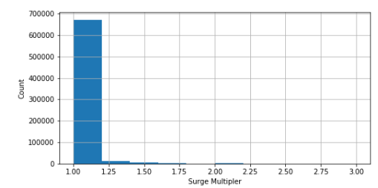
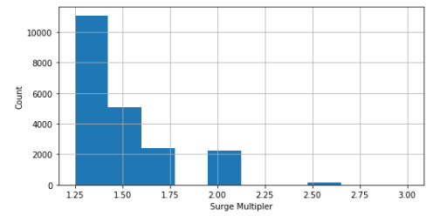
Description of Dataset
This dataset was pulled from Kaggle. It includes ~700K records and 57 columns with information on price, surge-multiplier for price, time, distance, weather, and other various features.
Some key data discoveries:
Only a very small proportion of records have a surge-multiplier, none of them being for Uber.
Data was only based on the months of November and December. Likely limits the noticeable impact of weather
Key decision: I decided to filter my dataset to only rides with surge-pricing. I felt the raw data was overly representative of rides with ‘baseline’ demand, and wanted to
Total dataset: n = 693,071
Filtered ‘surge’ rides: n = 20,975

Slide 4

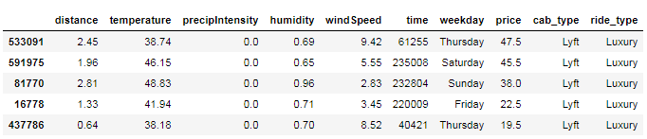
Global User-Defined Parameters
The global parameters below defined the data subset that would be used in all subsequent analysis and ML modeling. This was achieved using Python Class Objects and Functions
*Time, Weekday, and Ride_Type were derived variables. I also calculated a price per mile (‘ppm’) variable

Slide 5
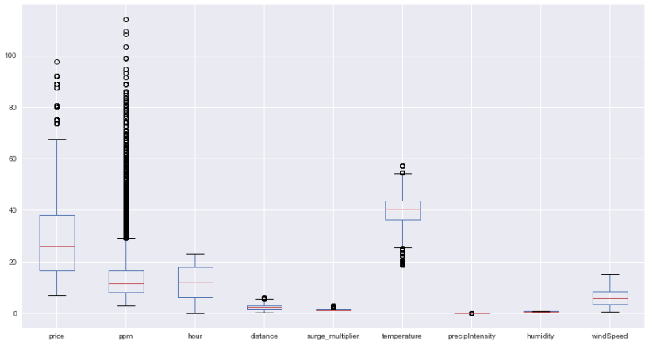
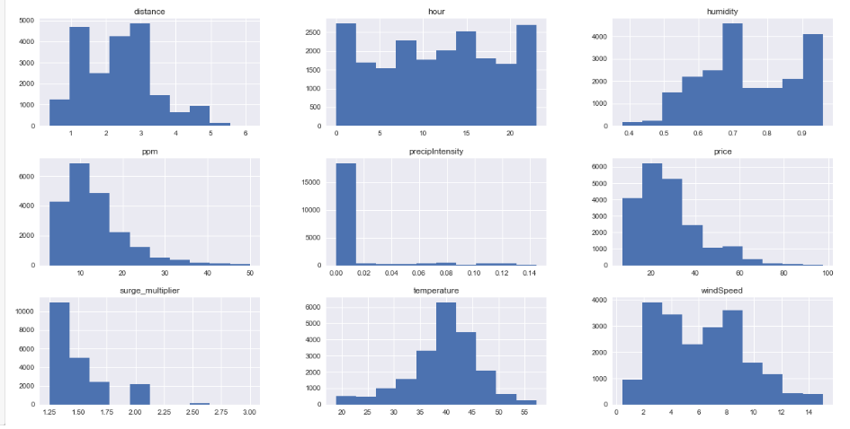
Distribution of Variables
Some distributions were skewed, but I chose to leave them as – is.

Slide 6
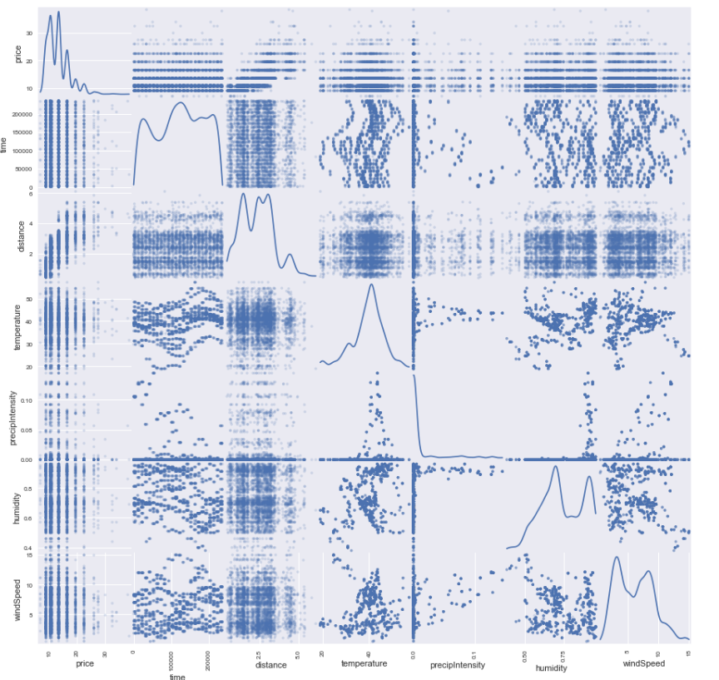
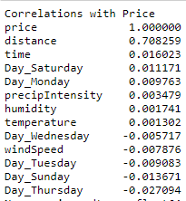
Correlation of Variables
Some distributions were skewed, but I chose to leave them as – is.
*Weekdays were incorporated into the model using one-hot encoding. A separate column was made for each weekday with a binary indicator of 1/0

Slide 7
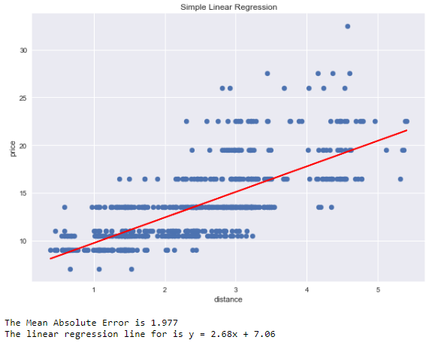
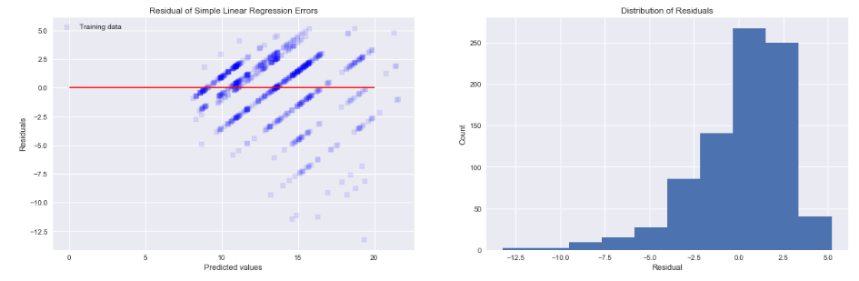
Simple Linear Regression
Using only distance as a predictor, there is a clear linear correlation with price. The regression plot and residuals are plotted below
Residuals

Slide 8
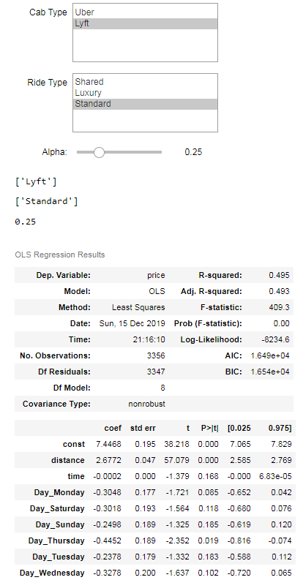
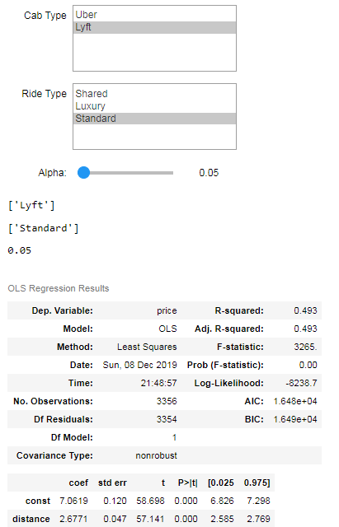
Multivariate Linear Regression
I used ‘backwards elimination’ to test for the significance of predictor variables in my multivariate model. One variable at a time is removed from my model until the only ones remaining have a p-value < alpha

Slide 9
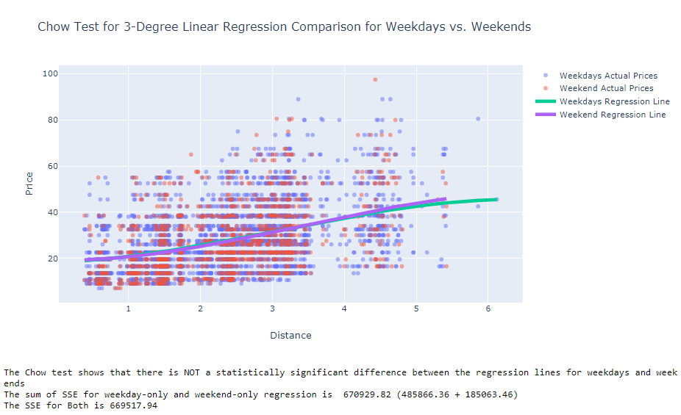
Chow Test
I used the Chow Test to see whether there was a statistically significant difference between the n-degree regression lines used for weekdays-only vs. weekends-only rides. There was no significant difference.

Slide 10
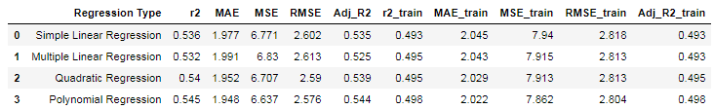
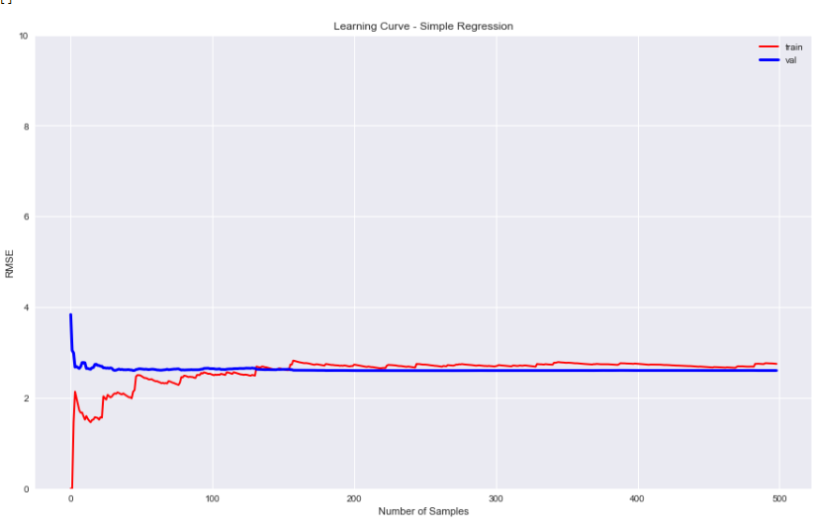
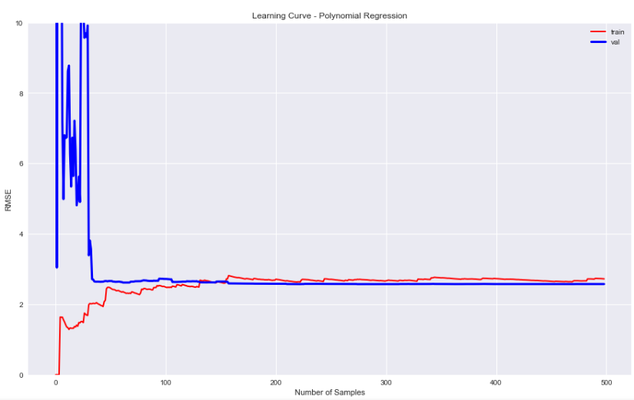
Linear Regression Results
Polynomial Regression performed the best on the test dataset. Multivariate regression performed the worst, but it did fit better than simple linear regression when validated against the training data it was fitted against.

Slide 11
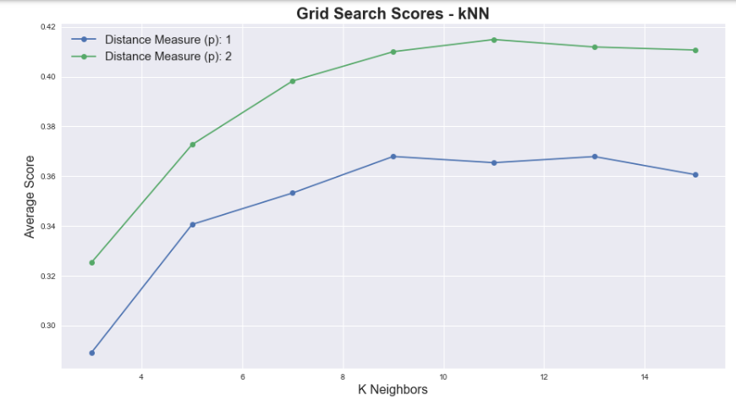

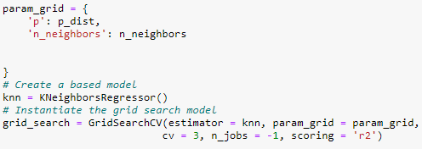
K-Nearest Neighbors
I used GridSearchCV to search for the optimal parameters in this model.
The parameters I hyper-tuned were distance measure (Euclidean vs. Minkowski) and number of K neighbors

Slide 12
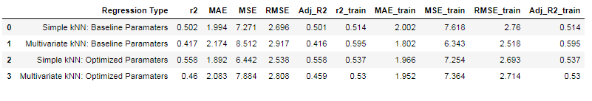
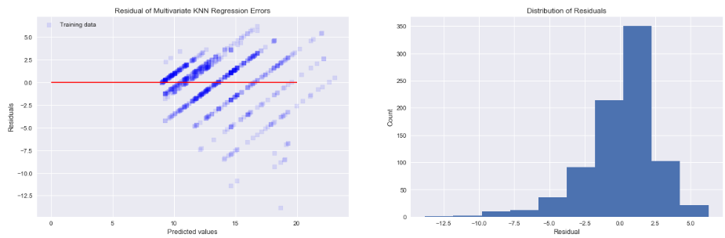
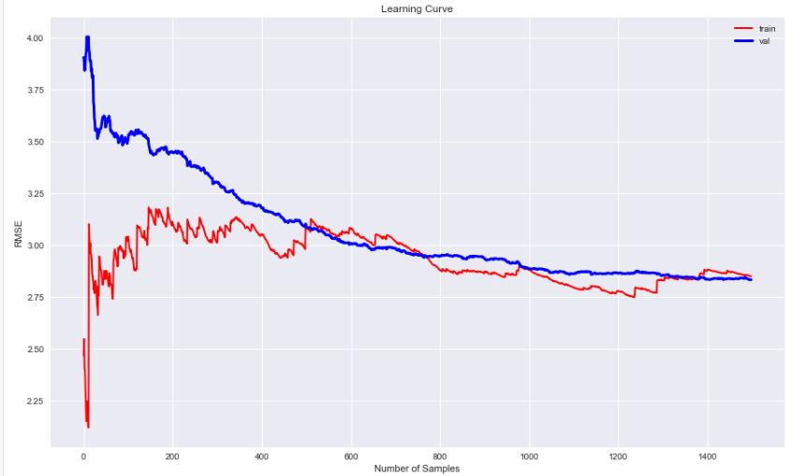
kNN Results
Across all metrics, simple regression with optimized parameters performed the best.
Residuals
Learning Curve (training vs. test data)

Slide 13
kNN Results
Across all metrics, simple regression with optimized parameters performed the best.
Residuals
Learning Curve (training vs. test data)

Slide 14
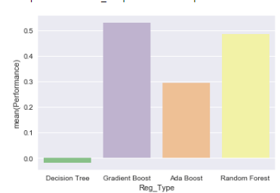
Decision Tree/Ensemble Methods
I did a quick test of Decision Trees Regression, Gradient Booting, Ada Boost, and Random Forest. Each model was tested against the 20% test data, and the default baseline parameters were used.
I decided to further pursue Random Forest and Gradient Boosting as viable options
Learning Curve (training vs. test data)

Slide 15
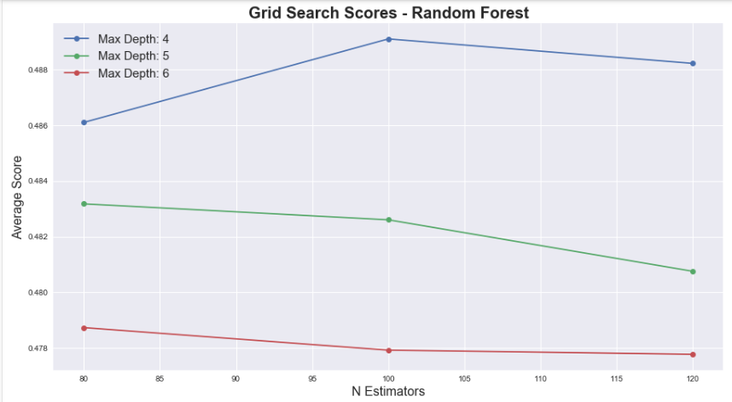
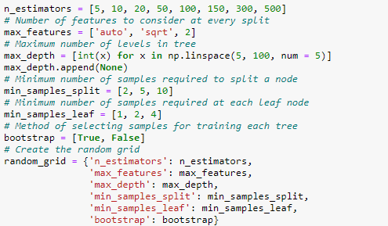
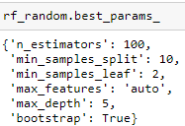
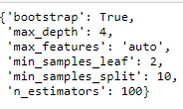
Random Forest
The Random Forest regression model was hyper-tuned to optimal values using RandomSearchCV and GridSearch functions

Slide 16
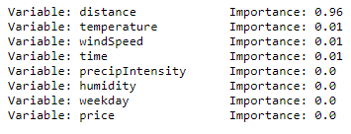
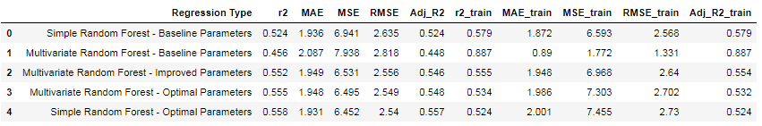
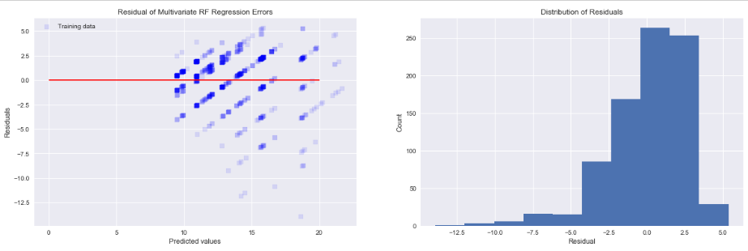
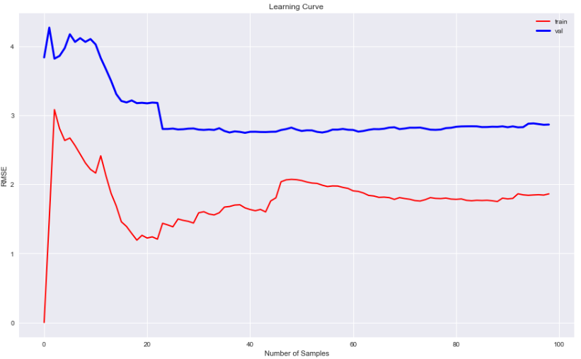
Random Forest Results
Once again, the simple regression models outperformed the multivariate models on the test dataset.
Feature Importance
Model Performance
Residuals
Learning Curve

Slide 17
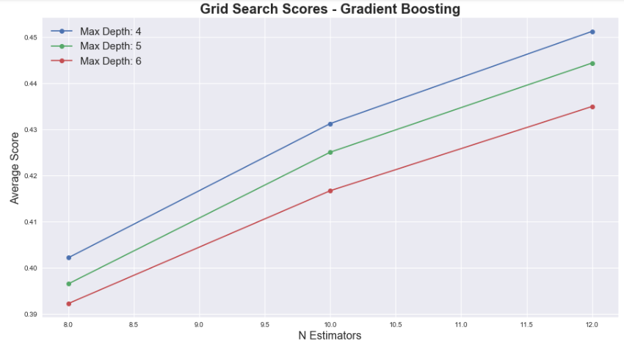
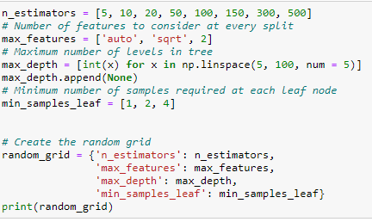


Gradient Boosting Regression
The Gradient Boosted regression model was also hyper-tuned to optimal values using RandomSearchCV and GridSearch functions

Slide 18
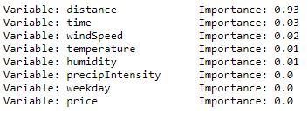
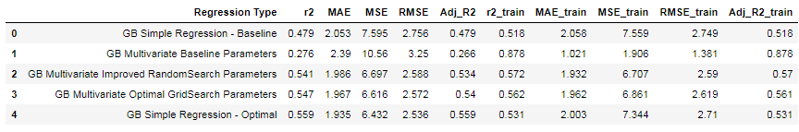
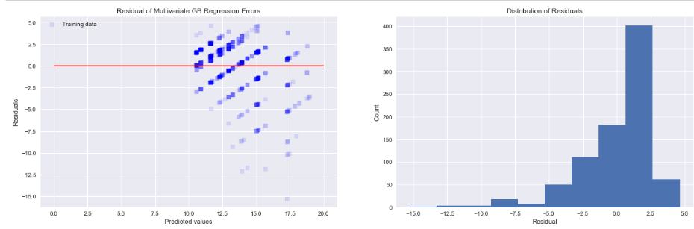
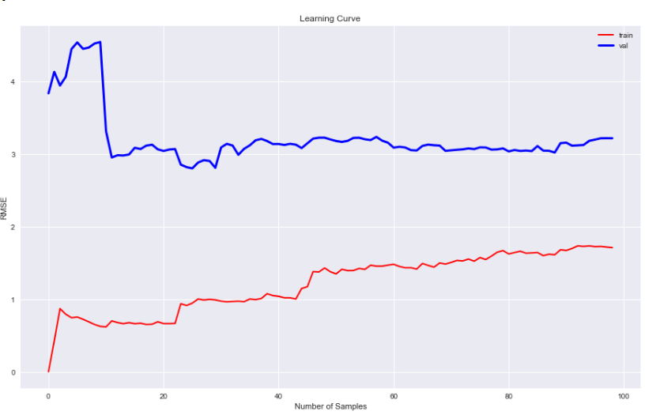
Gradient Boost Results
Once again, the simple regression models outperformed the multivariate models on the test dataset. This performed worse than the other models, and was most overfitted
Feature Importance
Model Performance
Residuals
Learning Curve

Slide 19

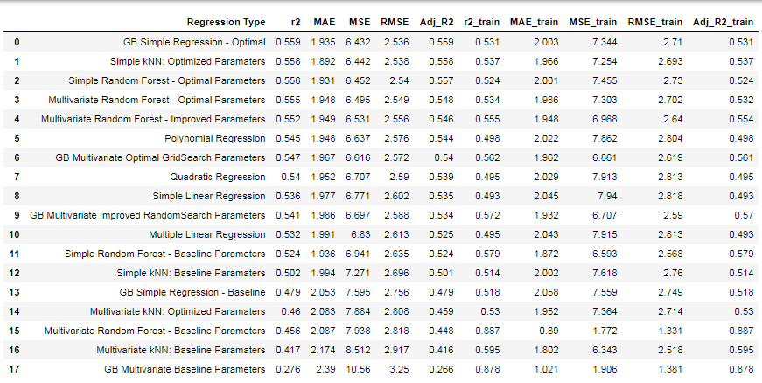
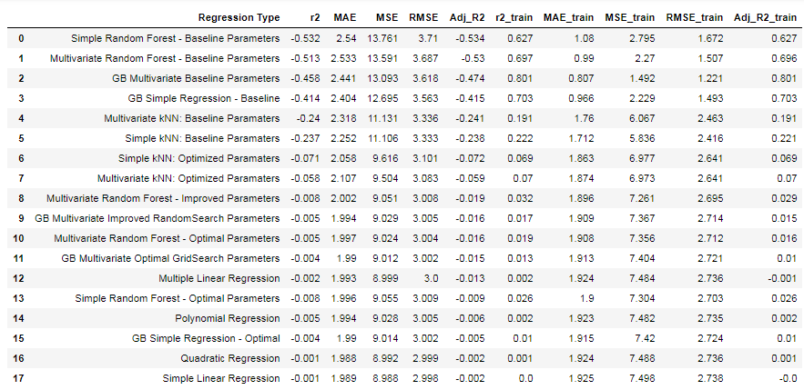
Overall Results
Overall Performance results are on the left. GradientBoost Simple Regession performed the best, closely followed by other simple regression models
I re-ran my notebook this time looking at Price Per Mile as the target variable to predict. I did not filter on surge-priced rides, and used a 10% sample subset. Results for this model were very poor (results on the right).

Slide 20
Future Enhancements
Explore additional data subsets
Potentially create new ones
More robust outlier analysis
Test other sampling methods, and use consistently
Enhance notebook to serve as template for regression analysis done on any (clean) dataset

